Slide 1
Computer Vision
First Meet – Introduction [Part 2]
ADF

Slide 2

Agenda
Part 1: Course Introduction, Course Preparations
Part 2: Brief history of Computer Vision
Part 3: Recognition and Detection
Computer Vision

Slide 3
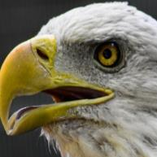
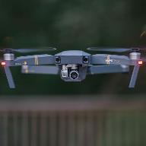
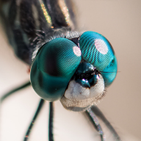
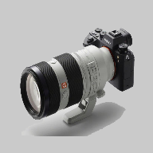
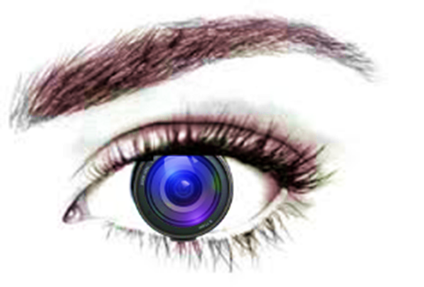
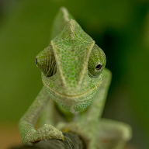
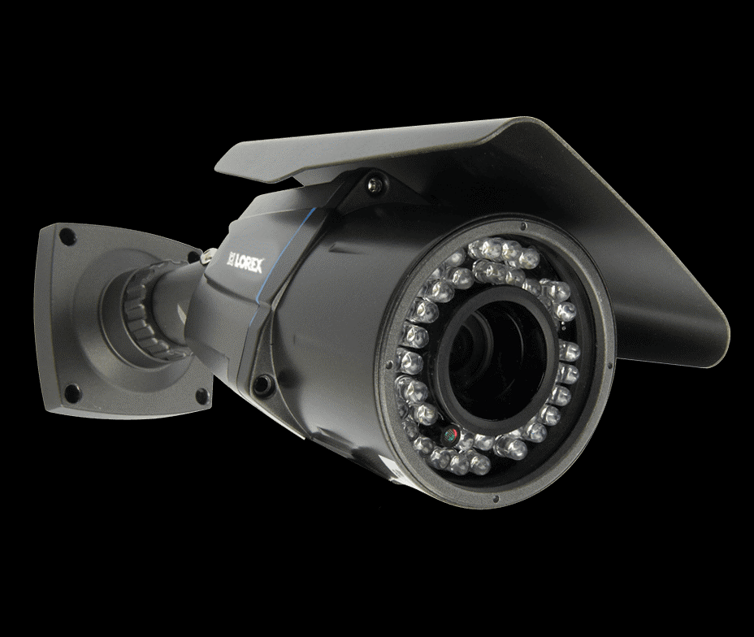
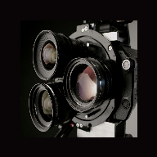

Computer Vision
Computer Vision
Notes:
https://www.lorextechnology.com/images/products/LBC7183B/900x600/Specialty%20Cams-LBC7183B-L4.png
https://c1.wallpaperflare.com/preview/24/845/211/drone-camera-flying-fly.jpg
https://cdn.pixabay.com/photo/2016/06/14/00/14/cat-1455468__340.jpg
https://deaqonjamesphotography.com/wp-content/uploads/2019/07/Alpha-Universe-ILCE-7RM4_-a7R-IV-_VX8003_right.jpg
https://www.dpreview.com/files/p/articles/0913748414/Lens_Turret_5.jpeg

Slide 4
Computer Vision
Biology
Neuroscience
Psychology
Optics
Cognitive Sciences
Physics
Speech
Computer Vision
graphics, algorithms, theory
Computer Science
Natural Language Processing
systems, architecture
Engineering
Robotics
Information Retrieval
Machine Learning
Mathematics
Computer Vision

Slide 5
Computer Vision
Artificial Intelligence
Natural Language Processing
Computer Vision
Deep Learning
Machine Learning
Robotics
Computer Vision

Slide 6
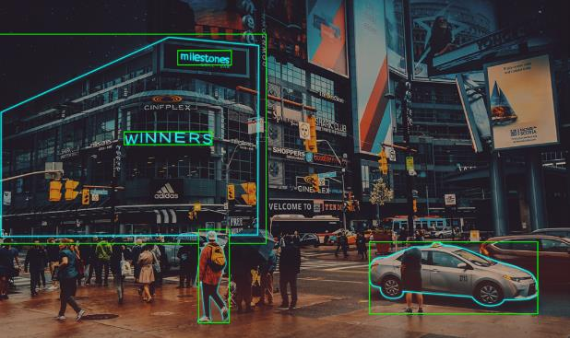
Computer Vision
One of the fastest growing field of A.I.
Computer Vision
Notes:
https://www.analyticsinsight.net/wp-content/uploads/2019/08/computer-vision-israel-1024x608.png

Slide 7
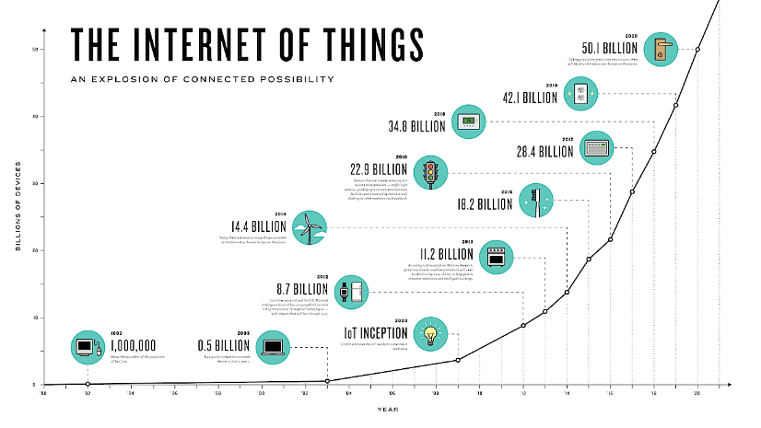
Explosion of Internet and Sensors
Computer Vision
Notes:
Image: http://patrickch.domain.com/wp-content/uploads/2014/11/Explosion-of-connectivity.png

Slide 8
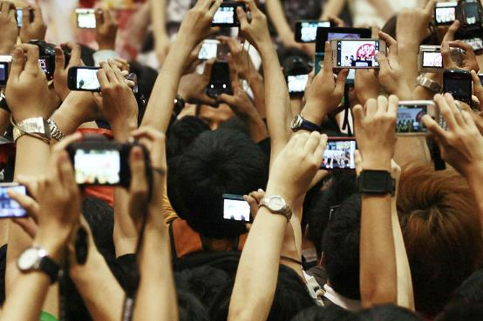
Computer Vision
Cisco: by 2016, >85% of Internet data is in form of pixels (multimedia)
Computer Vision
Notes:
https://www.nme.com/wp-content/uploads/2016/09/2013CameraPhonesPA-12884776310713-1.jpg

Slide 9
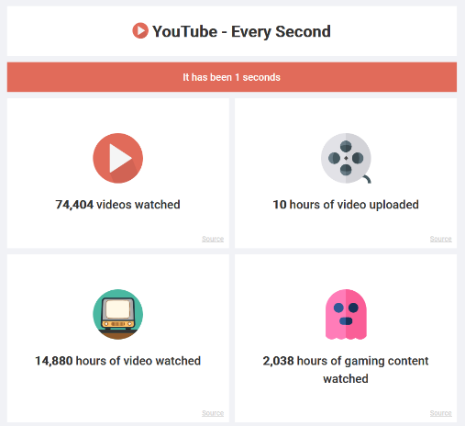
Computer Vision
YouTube : every second, about 10 hours of videos are being uploaded
Impossible to process manually
http://www.everysecond.io/youtube
Computer Vision
Notes:
Image: http://www.everysecond.io/youtube

Slide 10
Age of Vision
Computer Vision

Slide 11

Not This Vision
Computer Vision

Slide 12
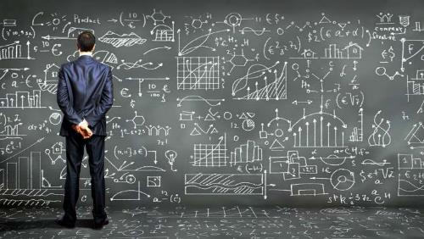
Computer Vision
Vision data (raw pixel data) are one of the hardest data to harness
Digital Dark Matter of The Internet
Computer Vision

Slide 13

Where’s Waldo?
Computer Vision

Slide 14
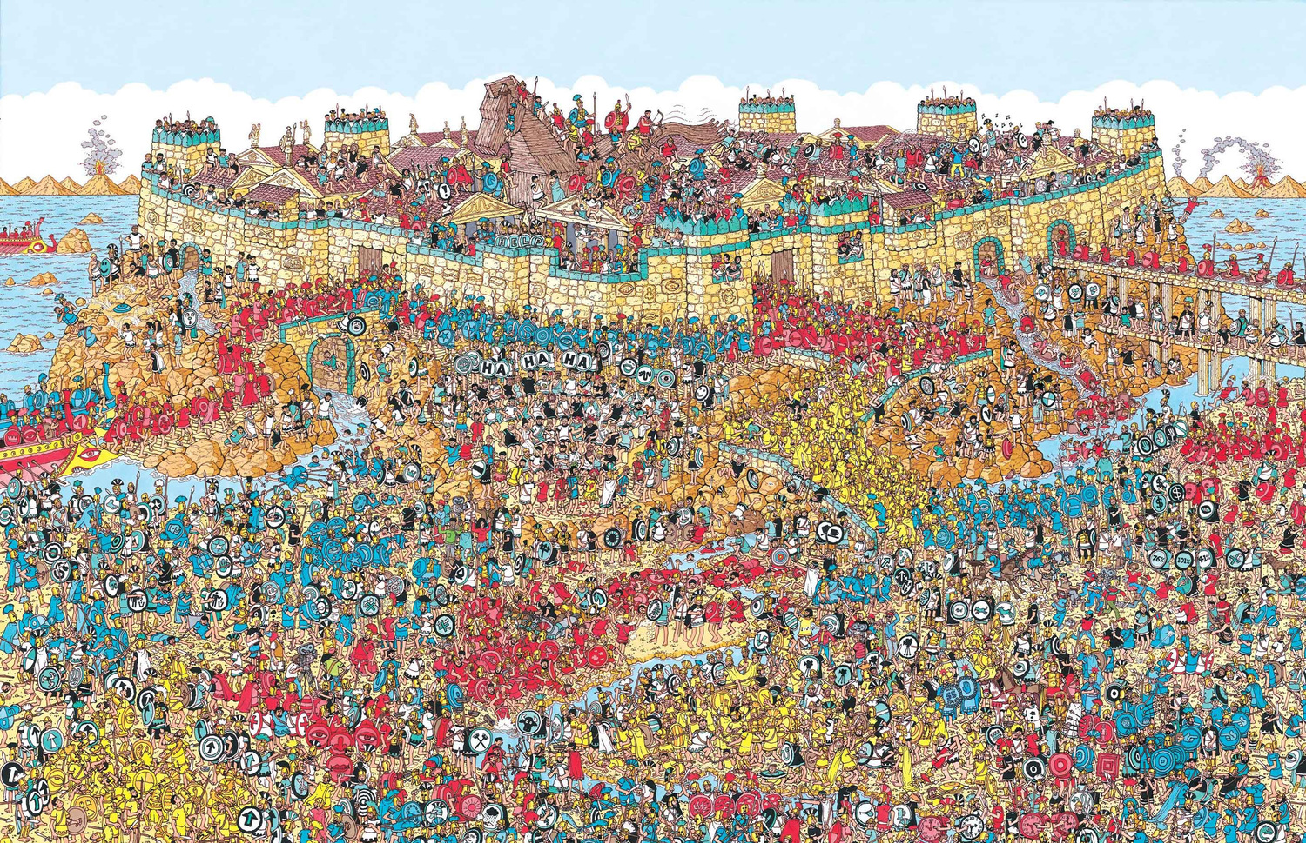
Where’s Waldo? (Extreme Edition)
Computer Vision

Slide 15

Where’s The Real-life Waldo?
Computer Vision

Slide 16

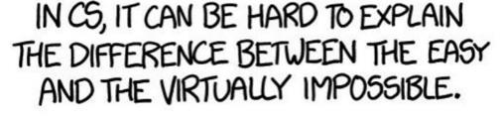
Computer Vision

Slide 17

What is Vision?
Computer Vision

Slide 18

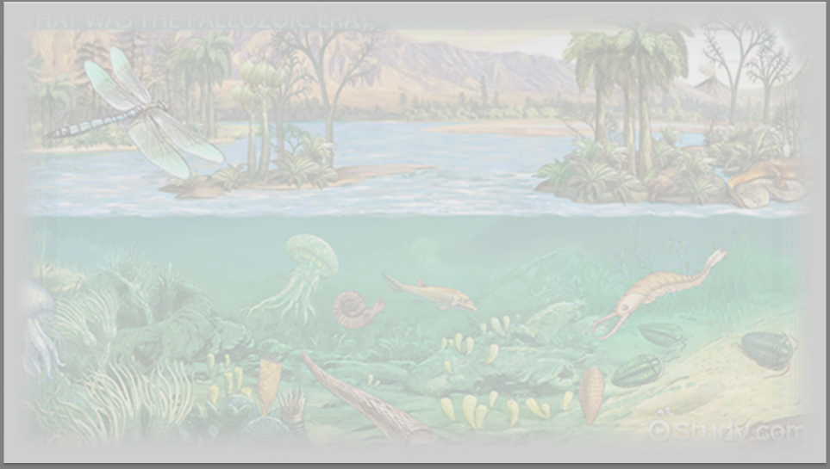
Vision Origin (?) ± 543 million years, B.C.
Computer Vision

Slide 19
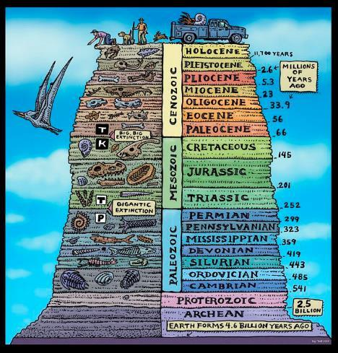
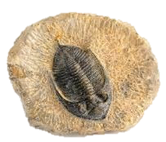


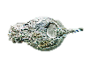

Cambrian Explosion
Computer Vision
Notes:
From fossils, Suddenly a huge explosion of species, called Speciation : from simple organism then become many species
Before 540 mil, scientist thought that earth is a peaceful place, abundant of water, pre-simple microorganism has no eyes,
Suddenly animal turn to more complex, why?

Slide 20
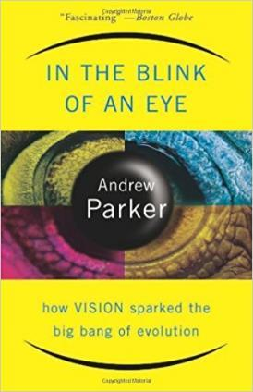
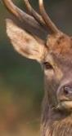

Light-Switch Theory: The onset of the eyes
Computer Vision
Notes:
Trigger? Most convincing Theory by Andrew Parker, Australian zoologist : the onset of the eyes, study from fossils
One of the trilobites, Olenellus -> pinhole-camera-like eyes in trilobyte -> know where food is -> biological arm race began, speciation began, vision become
Vision was one of the biggest factor of speciation

Slide 21

Computer Vision
Notes:
And so the speciation began (they say)

Slide 22
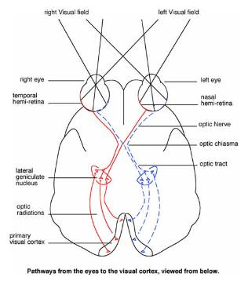
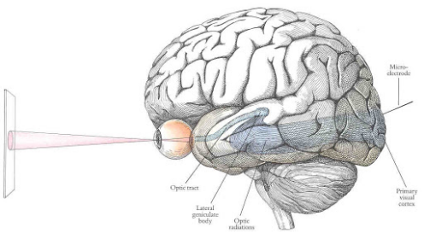
Primary Visual Cortex
Computer Vision
Notes:
Interesting -> primary visual cortex : back of the brain not near the eye, where olfactory cortical is right behind the nose, and auditory right behand the hears
Almost 50% brain involved in vision -> seem the hardest in sensory perceptive cognition in the brain

Slide 23
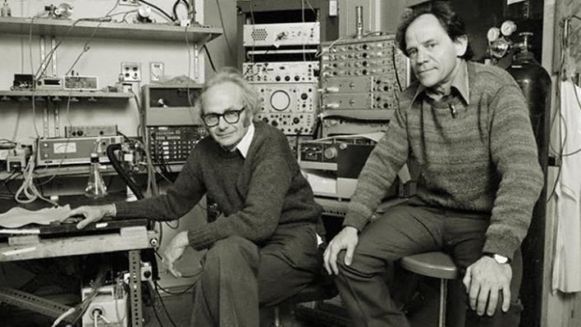
Hubel & Wiesel, 1959
Computer Vision
Notes:
Not engineering works, but science works, to answer the question: How does a visual work? Havard, Hubel & Wiesel, neurophysiologist
Awake but anaesthetized Cat -> push electrode into brain, Recording neuron activities
Check If the cats showed fishes, do the brain fire/spiked, but it doesn’t work
They was frustrated, but scientific discovery takes both luck and care and thoughtfulness
Show image using slides projector
Turns out the brain spiked each time when they changed slides
Turn out the brain interested in edges
Neurons organized in columns, and each columns like to see a specific orientation of the stimulus, a simple oriented bars, rather than a mouse image
Of course there’s more than neurons that only like simple bars
The beginning of visual processing is simple structures of the world : oriented edges
Big discovery in neurophysiology, neuroscience and engineering
You’ll see in deep neural net model, feature resembles edge like structure
Nobel prize in medical in 1981

Slide 24
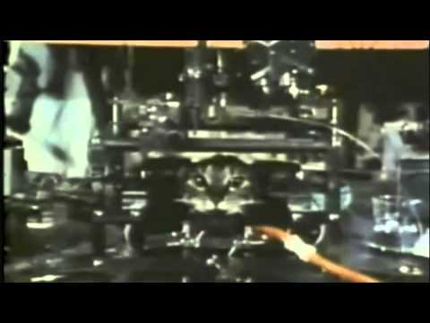
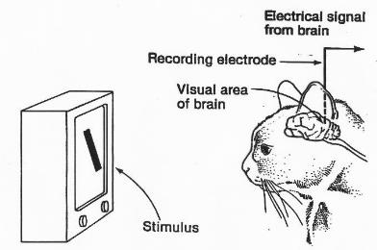
Hubel & Wiesel’s Cat
Computer Vision
Notes:
Not engineering works, but science works, to answer the question: How does a visual work? Havard, Hubel & Wiesel, neurophysiologist
Awake but anaesthetized Cat -> push electrode into brain, Recording neuron activities
Check If the cats showed fishes, do the brain fire/spiked, but it doesn’t work
They was frustrated, but scientific discovery takes both luck and care and thoughtfulness
Show image using slides projector
Turns out the brain spiked each time when they changed slides
Turn out the brain interested in edges

Slide 25
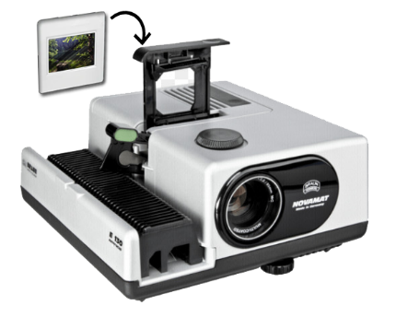
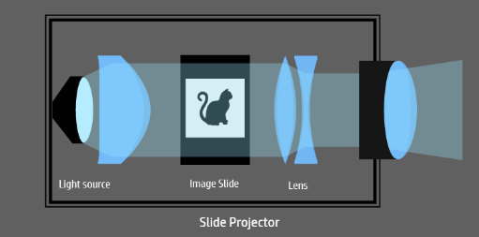
Hubel & Wiesel’s Cat
Computer Vision

Slide 26
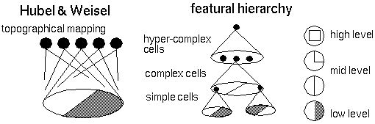
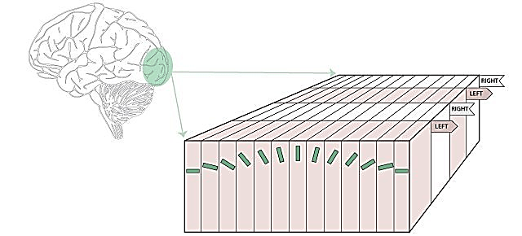
Visual Perception
Computer Vision
Notes:
Neurons organized in columns, and each columns like to see a specific orientation of the stimulus, a simple oriented bars, rather than a mouse image
Of course there’s more than neurons that only like simple bars
The beginning of visual processing is simple structures of the world : oriented edges
Big discovery in neurophysiology, neuroscience and engineering
You’ll see in deep neural net model, feature resembles edge like structure
Nobel prize in medical in 1981

Slide 27
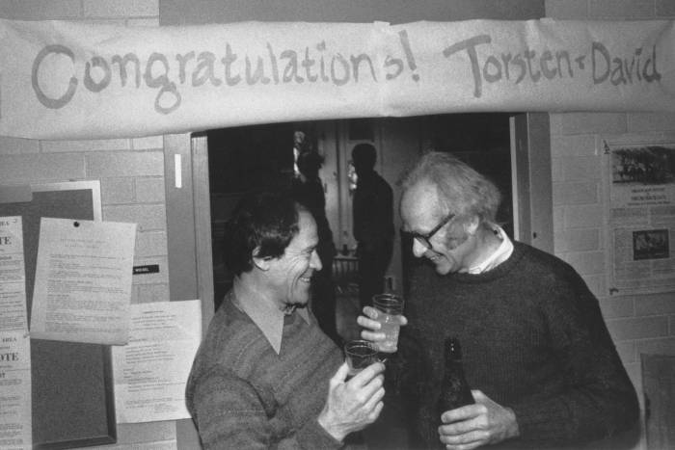
Computer Vision

Slide 28
How to create good representations of the visual world in a way it could be used to support recognition?
Computer Vision

Slide 29
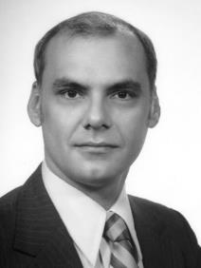
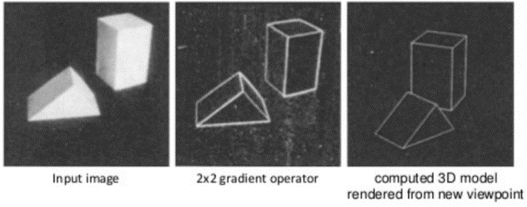
Block World
CV
[Larry Roberts, 1963]
1959
1963
Edges define the world
Extract edge-like Structures
The beginning of Computer Vision
Computer Vision

Slide 30
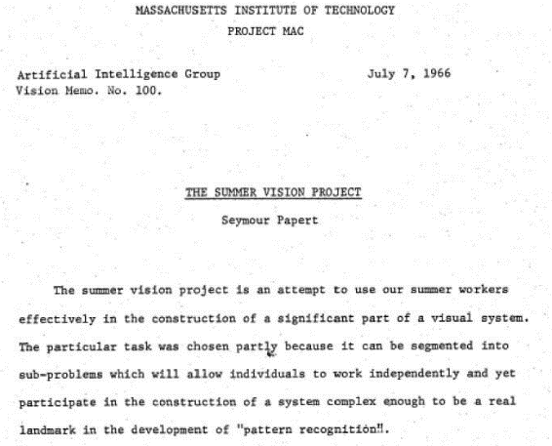
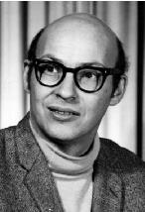
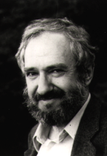
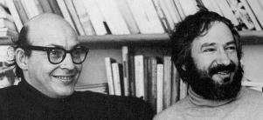
The Birth of Computer Vision
CV
1959
1963
1966
Marvin Minsky and Seymour Papert
Computer Vision

Slide 31
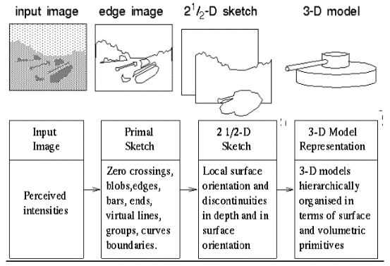

Stages of Visual Representation
CV
[David Marr, 1970s]
1959
1963
1966
1970
Computer Vision

Slide 32
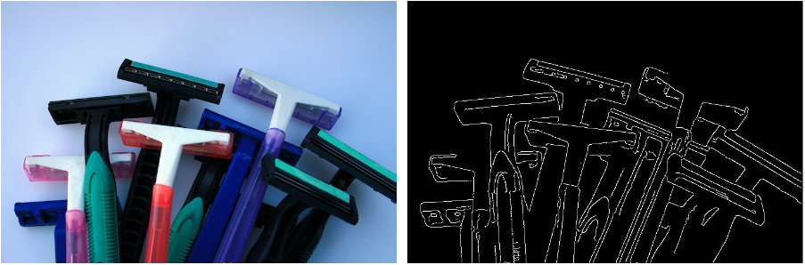
Recognition via Edge Detection
CV
[John Canny, 1986]
[David Lowe, 1987]
1959
1963
1966
1970
1986
AI Winter II
Computer Vision

Slide 33
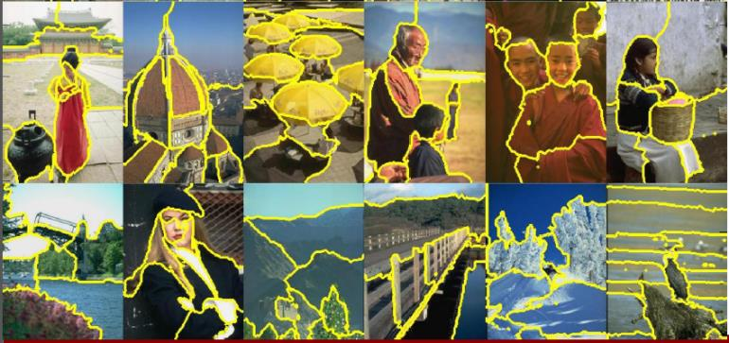
Recognition via Grouping
CV
AI Winter II
Normalized Cuts
[Shi & Malik, 1997]
1959
1997
1963
1966
1970
1986
Computer Vision

Slide 34
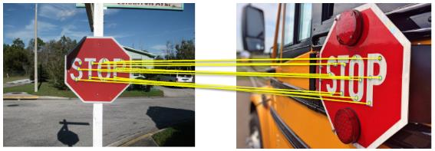
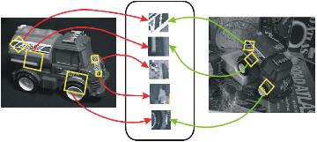
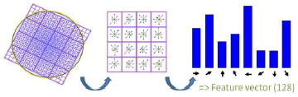
Recognition via Matching
CV
AI Winter II
Scale-Invariant Feature Transform (SIFT)
[David Lowe, 1999]
1959
1997
1963
1999
1966
1970
1986
Computer Vision

Slide 35
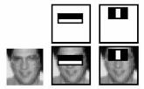
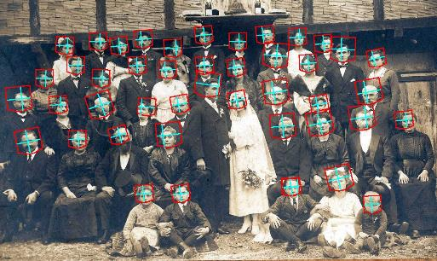
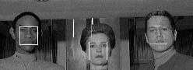
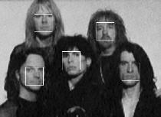
Face Detection
CV
AI Winter II
[Viola & Jones, 2001]
1959
1997
1963
1999
1966
2001
1970
1986
Computer Vision

Slide 36
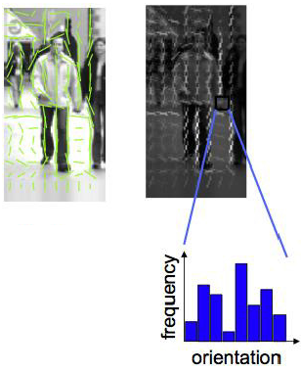
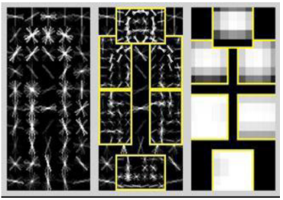
Recognition via Features and Parts
CV
AI Winter II
1959
1997
1963
1999
1966
2001
1970
2005
1986
Popularity of AI/ML in CV
Histogram of Oriented Gradients (HOG)
[Dalal & Triggs, 2005]
Deformable Part Model
[Felzenswalb, McAllester, Ramanan, 2009]
Computer Vision

Slide 37
International Challenge in Computer Vision
Computer Vision

Slide 38
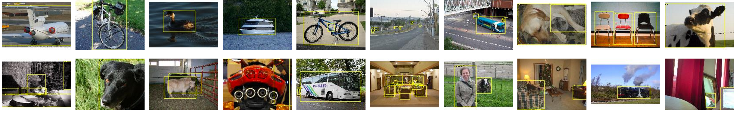

PASCAL Visual Object Challenge
[Everingham et al. 2006-2012]
2012 Dataset :
~11500 images
20 object categories
Computer Vision
Notes:
20 object categories

Slide 39

PASCAL Visual Object Challenge
[Everingham et al. 2006-2012]
Computer Vision
Notes:
20 object categories

Slide 40

IMAGENET Large Scale Visual Recognition Challenge
Computer Vision

Slide 41
ILSVRC Challenge
IMAGENET Large Scale Visual Recognition Challenge
1,431,167 images (from 14,197,122 images)
1000 classes (from 21841 synsets indexed)
Top-5 Classification criteria
Full train dataset: 1.3TB
Mini dataset 64x64: 12.7GB train, 509MB val
Mini dataset 32x32: 3.4GB train, 134MB val
Computer Vision

Slide 42
ILSVRC Challenge
CNN
Classification error
Beat human
Lin et al | Sanchez & Peronin
HOG+LBP+SVM | FV+PQ+SVMs
Krizhevsky et al | Zeliler & Vergus | Simonyan & Zisserman | Szegedy et al
(AlexNet) | (ZF-Net) | (VGG) | (GoogLeNet)
He et al | Shao et al | He et al
(ResNet) | ensemble | (SENet)
Russakovsky et al
Computer Vision
Notes:
Imagenet large scale visual recognition challenge
1000 object classes, over 1.4 mil images
2012 : year the winning of imagenet challenge is Computer Vision
CNN was not invented in 2012, but invented in 70-80s,
CNN Showed massive power as high capacity end-to-end training architecture and won the imagenet challenge by huge amount
Beginning of Deep Learning Revolution

Slide 43
CVPR 2019 Award
Computer Vision

Slide 44
Number of Training Pixels
1.E+12
1.E+11
1.E+10
1.E+09
1.E+08
1.E+07
1.E+06
~251B
~154M
~154M
~47M
Convolutional Neural Network

Slide 45
There is a number of visual recognition problems that are related to image classification, such as object detection, image captioning, video classification
Computer Vision

Slide 46




Basic Computer Vision Challenge
Computer Vision
Notes:
Object Detection, Action Classification, Image Captioning
Dense labeling of the entire scene with perception grouping

Slide 47


Basic Computer Vision Challenge
Computer Vision
Notes:
Object Detection, Action Classification, Image Captioning
Dense labeling of the entire scene with perception grouping

Slide 48






The quest for visual intelligence goes far beyond object recognition…
Computer Vision

Slide 49

CVPR Trends
Convolutional Neural Network

Slide 50

CVPR Trends
Convolutional Neural Network

Slide 51

CVPR Trends
Convolutional Neural Network

Slide 52

The Quest of Visual Intelligence
Computer Vision
Notes:
Telling story from image
Psychology, even an image was shown only 500ms, people can write essay about the image
Very boring if all computer say is the list of objects

Slide 53
Computer Vision Technology Can Better Our Lives
Computer Vision

Slide 54

Now it’s your time
Computer Vision

Slide 55

Where’s Waldo? (Extreme Edition)
Computer Vision

Slide 56


Where’s Waldo? (Extreme Edition)
Computer Vision

Slide 57

Break, Question?
Computer Vision

